Slide 1
Math GR 5430 Final Review
5/3/2023
Winnie & Xiaoyang

Slide 2
Final Exam Format
Very similar to the midterm format
True or False, Multiple choices, fill in the blanks, short answers, basic Python literacy, basic Python library literacy, etc.
Focuses heavily on the second half of the course
But still includes some of the key concepts from the first half
“best prep for students is to go over the lecture notes and understand the concepts.”

Slide 3
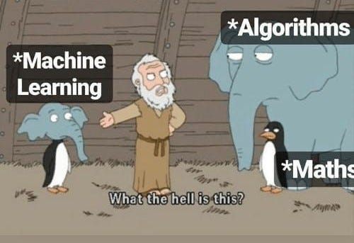
Important Things for the First Half of the Course
Framing the ML problem
Data and Feature Engineering
Loss and Gradient Descent
Regularization and Overfitting
Supervised vs Unsupervised learning

Slide 4
Second Half
Clustering (HW3)
NLP (HW3)
ANN (HW4 on LSTM)
Time Series (HW5)
RL (Lite)
NO ML in the Cloud
Project 1 & 2

Slide 5
Clustering
In Supervised learning, we would like our models to predict certain labels.
In Unsupervised learning, we do not have any labels. We would like to infer certain structures inside our dataset.
One of the most important ways to do unsupervised learning is to cluster, i.e. group similar data together based on some criteria.
At the same time, we would like data points in different clusters to be as different as possible.
Clustering can be used to improve the accuracy of supervised learning.

Slide 6
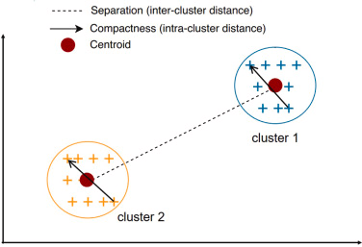
Cluster Metrics
Inertia or within-cluster sum-of-squares criterion
The lower the inertia is, the better our clustering is.
Dunn Index
Dunn Index = min(Inter cluster distance)/max(Intra cluster distance)
The higher the Dunn Index is, the better our clustering is.

Slide 7
K-means Clustering
K: number of clusters/centroids
Elbow curve to determine K
K-means Algo:
Randomly initialize k centroids
Repeat until convergence:
Assignment step: Assign each observation to the cluster with the nearest mean: that with the least squared Euclidean distance.
Update step: Recalculate means (centroids) for observations assigned to each cluster.

Slide 8
K-Means++
A better way to initialize centroids: We have a higher probability of choosing farther centroids.
The exact algorithm is as follows:
Choose one center uniformly at random among the data points.
For each data point x not chosen yet, compute D(x), the distance between x and the nearest center that has already been chosen.
Choose one new data point at random as a new center, using a weighted probability distribution where a point x is chosen with probability proportional to D(x)^2.
Repeat previous two steps until k centers have been chosen.
Now that the initial centers have been chosen, proceed using standard k-means clustering.

Slide 9
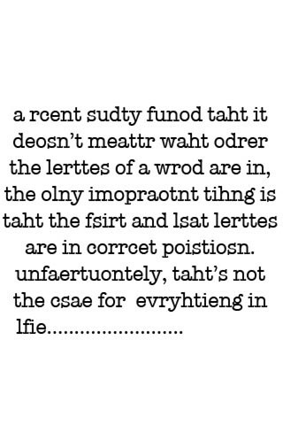
Natural Language Processing: NLP
Language data vs other data:
Each human language with different rules
Multiple meanings of one word
Context
Errors/Typos
Sparsity: language has many words, but a piece of text can have very few

Slide 10
Linguistics 101
Three aspects of a piece of text:
Semantic: the meaning of word
Syntax: the structure of sentence or phrase
Context: how a word, phrase, or sentence appears in a larger context
Fully understanding text requires all three components and can be difficult.

Slide 11
Common Techniques used in NLP
Syntactic Analysis:
Tokenization: break down text into pieces that machine can understand
Part of Speech tagging: identify each token as noun, adjective, etc. and tag it
Lemmatization and Stemming: Return base form vs chopping off ends directly
Stop-word removal: Remove words that don't add any meaning e.g. I, they
Semantic Analysis:
Word sense disambiguation
Relationship extraction

Slide 12
Different NLP Models
Text Classification
Naive Bayes
SVM
Deep learning
Sentiment analysis
BERT (Bidirectional Encoder Representations from Transformers) and
FINBERT (most failures are from telling between positive and neutral labels)
Large Language Models (Think ChatGPT)
Emergence based on a Threshold of Complexity

Slide 13
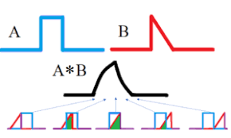
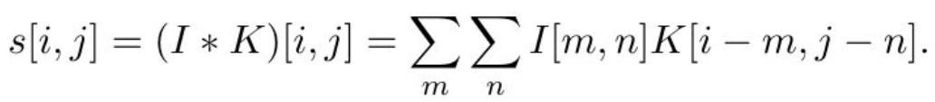
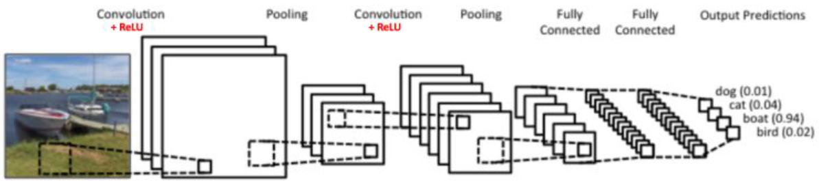
CNN - Convolution
Convolution operation
Integral of overlap of two functions
Four parts of CNN: convolution, non-linearity (eg: relu), pooling, fully connected layer (output/classification)

Slide 14
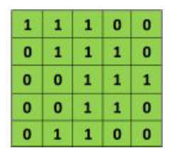
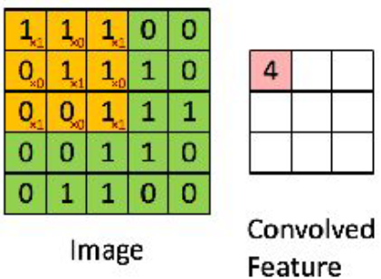
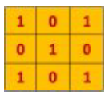
CNN - Convolution
Filter
Like weight parameters, random initialization, learned during training
Different values of filter matrix produce different feature maps for the same input, eg. edge detection, sharpen.
Multiple filters - multiple feature maps
Feature map (output of convolution)
Influenced by depth (number of filter), stride, zero-padding
- output shape when filter 2*2, stride = 1? to make output 5*5, zero padding one side?
- output shape when filter 3*3, stride = 2?
Notes:
(W - F + 2P)/S+1

Slide 15
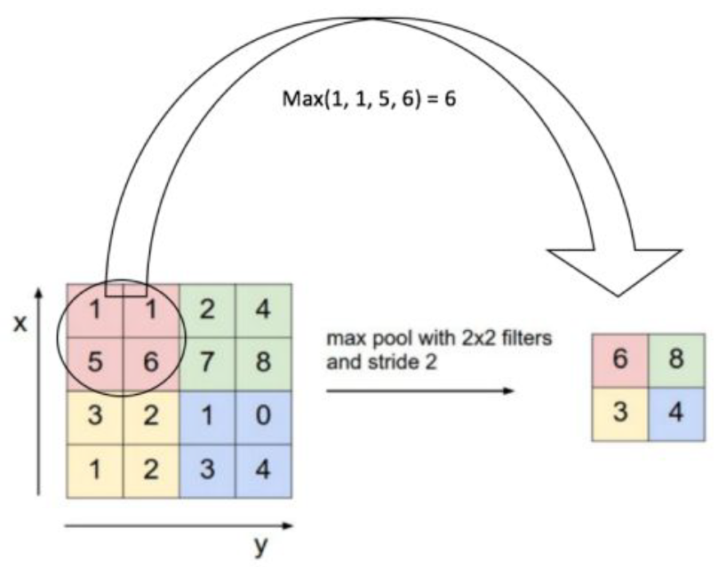
CNN - pooling
W’ = (W - F + 2P)/S+1
reduces the dimensionality of each feature map but retains the most important information.
control overfitting, reduce computation, makes
the network invariant to small transformations
Common types: max, average, etc.
2*2 average pooling,
stride = 3?
2 | 4 | 0 | 8 | 4
5 | 0 | 1 | 2 | 0
2 | 3 | 7 | 1 | 6
3 | 0 | 2 | 5 | 7
8 | 5 | 3 | 4 | 2

Slide 16
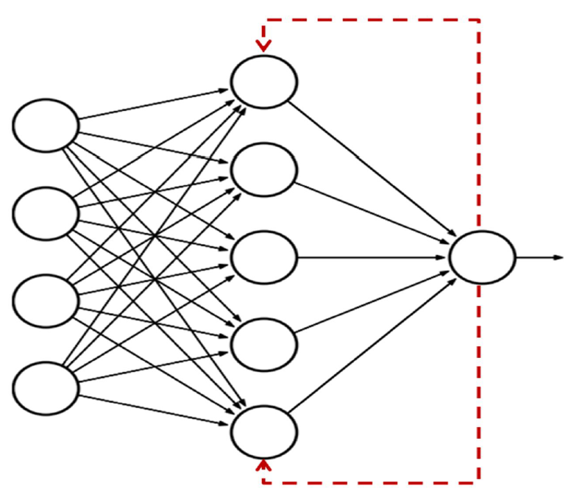
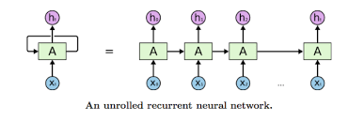
Recurrent neural networks (RNNs)
can be thought of as multiple copies of the same network, each passing a message to a successor.
work very well with sequences of data as input.
Repeat module: h_t = f(w[h_t-1, X_t]+b)
f: non-linearity, eg, tanh
Disadvantages:
Problem of long-term dependency
Vanishing or exploding gradient problem
Slow to training

Slide 17
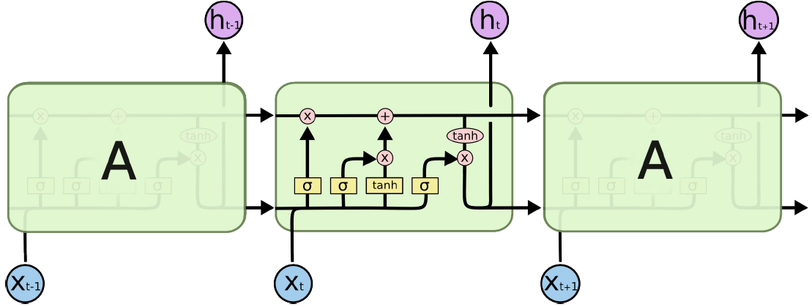
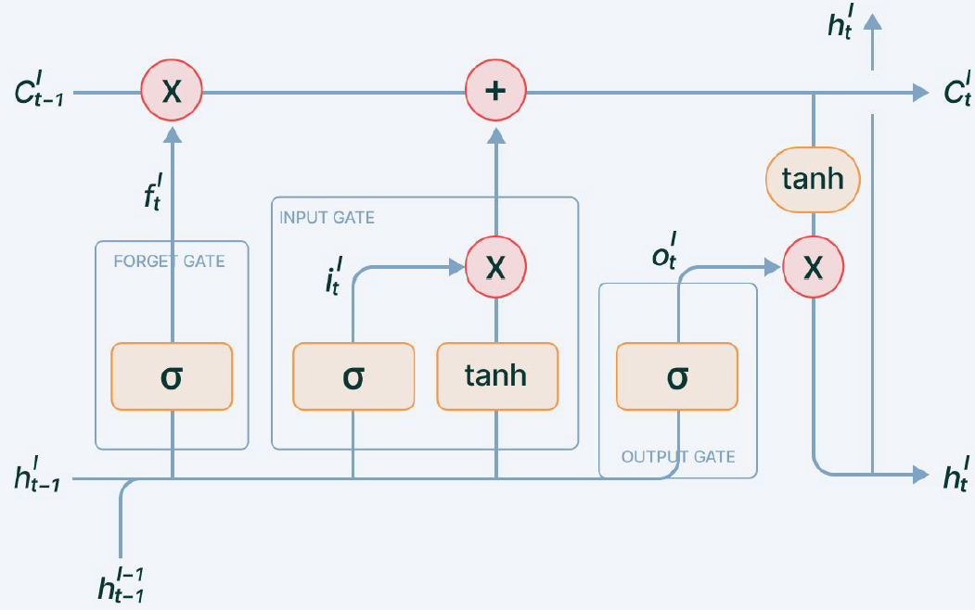
Long Short Term Memory (LSTMs)
capable of learning long-term dependencies
Identify gates
x_t

Slide 18
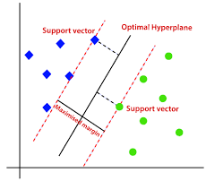
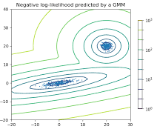
GAN - Discriminative and Generative model
Discriminative model: “tell a dog from a cat”
Given a set of data X and labels Y, learn the boundary between labels
Map features to labels
Capture the conditional probability P(Y|X)
Example: Logistic regression, SVM
Generative model: “how to generate figures of dog”
Given a set of data X and labels Y, generate likelihood of X joint by Y
Capture the joint probability p(X, Y) or just p(X) if there are no labels
Can generate new data instances
Example: Gaussian Mixture Model (GMM)
Need to learn full data distribution (harder)

Slide 19
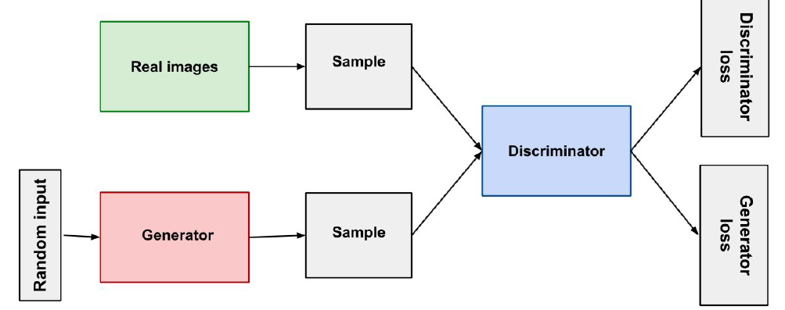
Generative Adversarial
Networks (GANs)
Generator and discriminator are neural networks
Generator - generate data from random input, output fed to discriminator
Discriminator - classifier (tell real data from fake data from generator)
Discriminator loss:
penalizes the discriminator for misclassifying a real instance as fake or a fake instance as real
ignore generator loss during discriminator training
Generator loss:
Penalizes the generator for sample correctly identified as fake by discriminator
Only generator weights changed during generator training

Slide 20
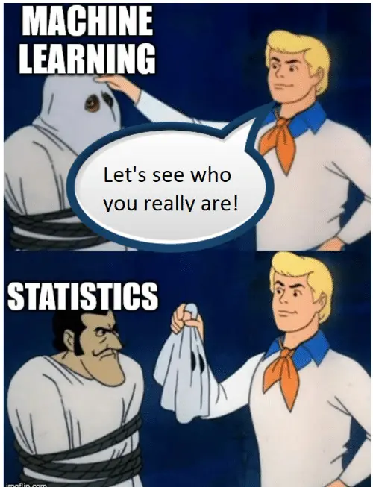
Time Series
Pandas dataframes work with tabular data. Time series is 1d series indexed by timestamp.
Classical Stats TS Models:
Naive model
Exponential Smoothing Model
ARIMA/SARIMA
ML TS Models:
mostly Linear Regression, Regression, and ANN

Slide 21
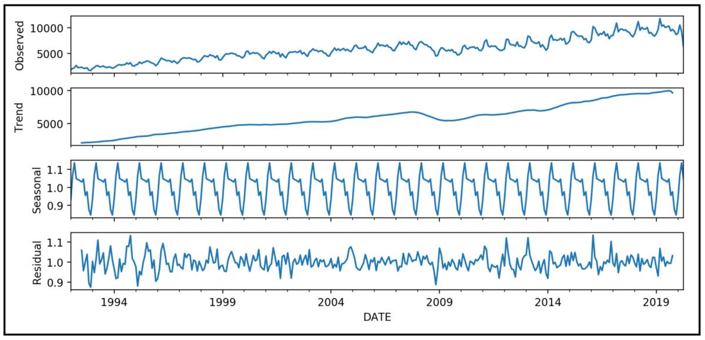
Things to consider when dealing with TS data
Trends
Seasonality
Noise
Cyclicity - repetitive changes
Autocorrelation
Stationarity
Differencing
Windowing: Fixed vs Rolling Forward Partitioning

Slide 22
Reinforcement Learning: RL
Models that “learn from mistakes”: Correct error occurred during the training process
Complex models with heavy computation
Gaming - AlphaGo
Robotics - React with changing environment
The model makes decisions based on Reward function: Positive vs Negative RL

Slide 23

RL Basics: Action-Reward Feedback loop
Agent: program controlling the object
Environment: the physical world
State: current situation of the agent
Reward:feedback from the environment
Policy: algo used by agent to decide its actions
Value: future reward by taking action
Exploration and Exploitation
At time, the environment is in state
The agent observes the current state and selects action
The environment transitions to state and grants the agents reward
This process then starts over for the next time step.

Slide 24
RL Algos
Model Based: if the agent can somehow predict the reward before performing it thereby planing what it should do
MDP (Markov decision process)
Model-free: Try something and then learn from it
Q-learning: Update Q table of state-action pairs through moves/episodes
Deep Q-Networks: When Q table is huge, replace it with a neural network

Slide 25
We hope you have learned something from this course!
Thanks for coming!!
Good luck!!!

